Slide 1

xinfai.
All-in-one
construction
project controls
Powered by AI
AI Assistant, AI Feeder and Knowledge Base

Slide 2
xinfai.
02
The project information gap
Project teams need a shared view of delivery and the evidence behind it.
Scattered records
Repeated follow-up
Schedules, site reports and commercial records sit in separate places.
Teams spend time asking for status and locating the latest approved information.
Xinfai connects project controls with the knowledge teams use to make decisions.

Slide 3
xinfai.
03
One system across the project
A shared project workspace for planning, delivery and commercial control.
Planning and progress
Programme, Primavera XER, baselines and activity updates
Site and resources
Daily records, people, materials and activity evidence
Procurement and stores
Requirements, purchase orders, reservations and stock movements
Commercial and finance
Contracts, BOQ, valuations, certificates, invoices and payments
Dashboards, project registers, access controls and audit history connect the workspace.

Slide 4
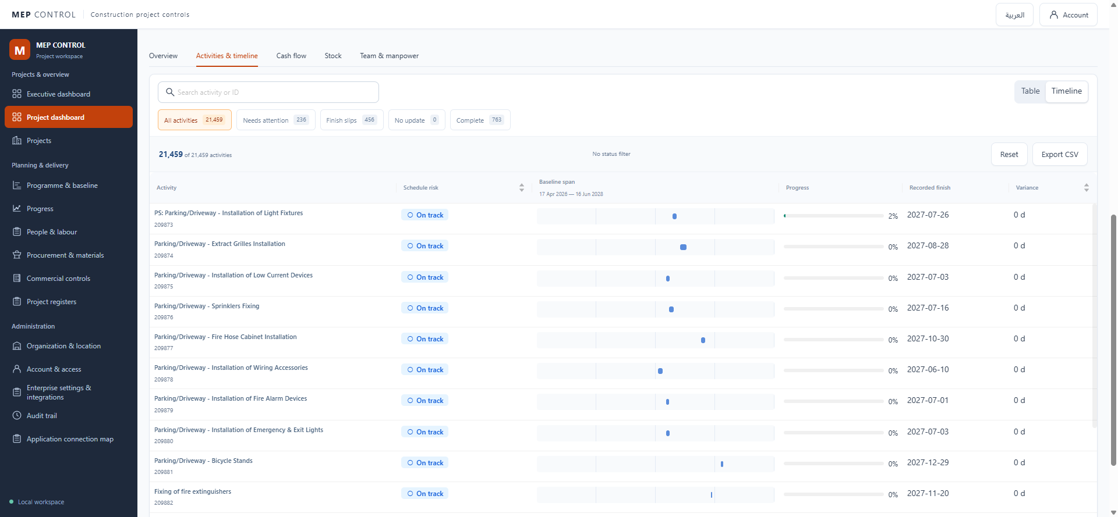
xinfai.
04
Programme and progress control
Imported schedules and saved updates provide a reviewable view of delivery.
Primavera XER import
Baseline version review
Activity timelines
Governed progress updates
Variance and exception filters

Slide 5
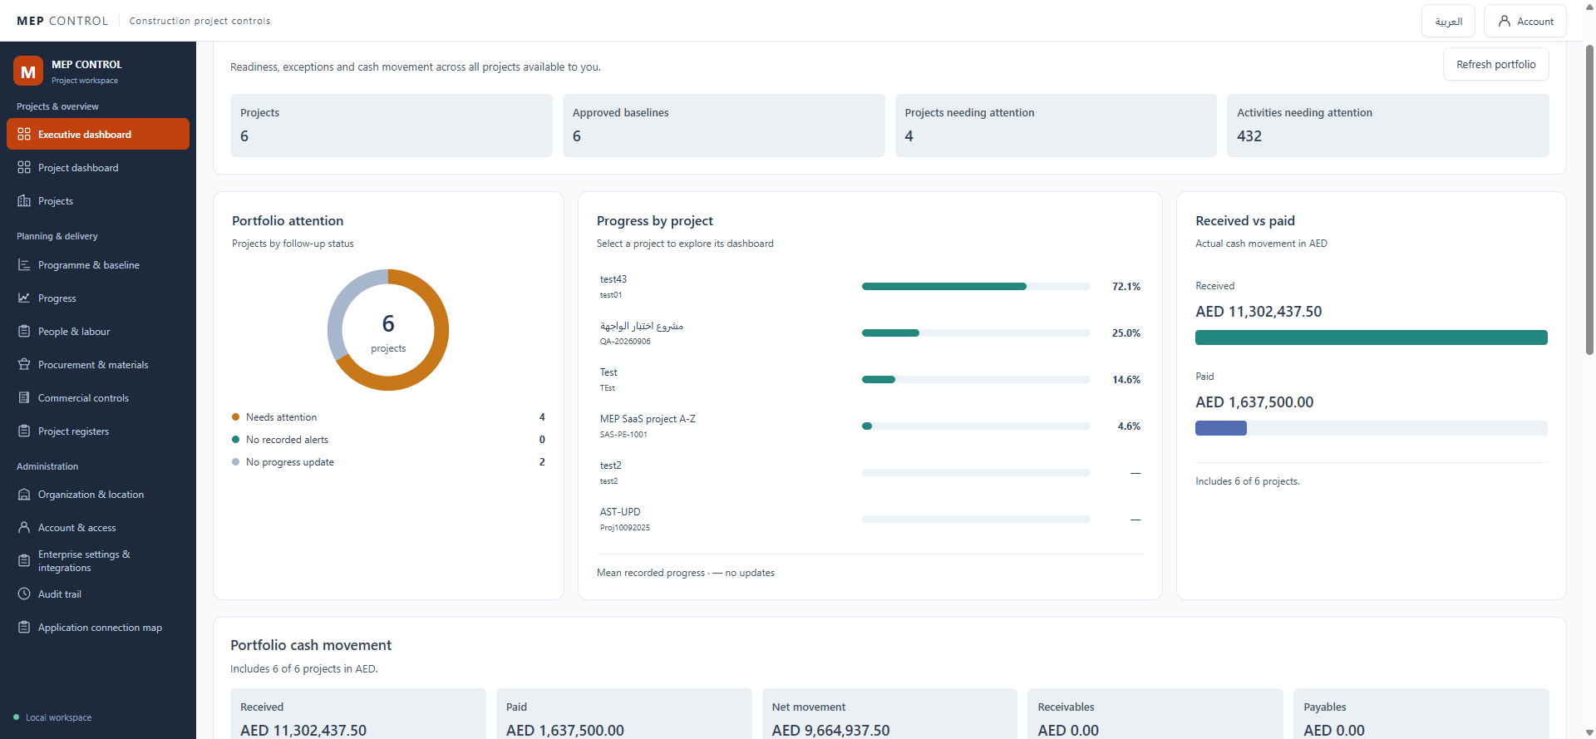
xinfai.
05
Delivery and commercial visibility
Project records bring operational follow-up into the same workspace.
Portfolio attention
Engineering and quality logs
Material coverage and stock
Commercial change registers
Cash movement and balances
Archived product screen. Values illustrate workspace records.

Slide 6
xinfai.
06
AI connected to your project context
The Assistant uses authorized context. The Feeder prepares knowledge for retrieval.
AI Assistant
AI Feeder
Knowledge Base
Ask questions in English or Arabic.
Restricted pilot.
Prepare documents for reviewed publication.
In development.
Retrieve approved, permitted content.
Integration planned.
Project records + approved knowledge + current access permissions

Slide 7
xinfai.
07
AI Assistant
A conversational entry point for guidance and selected project information.
“What is the latest saved
progress for this project?”
Current pilot
English/Arabic guidance
Selected project context
Planned capability
Update progress and status
Review and confirm before saving
“Update this activity to 60% complete
and set its status to In progress.”
Progress and status updates are planned. The current restricted pilot supports read-only guidance.

Slide 8
xinfai.
08
AI Feeder
A controlled path from uploaded files to approved project knowledge.
01
02
03
04
Upload
Prepare
Review
Maintain
Choose the project, document owner and audience.
Extract text, preserve source references and index it.
Check extracted content and approve publication.
Replace, unpublish or revoke outdated knowledge.
In development. PDF, DOCX, DOC, Markdown and TXT are target formats.

Slide 9

xinfai.
09
Knowledge Base
Approved information, organized for project-specific questions.
Policies and procedures
Approved project documents
Document owners and revisions
Shared or executive audiences
Current publication status
Integration planned. Only published, current and authorized content should reach an answer.

Slide 10
xinfai.
10
A project knowledge workflow
Illustrative target use case: a team member asks about an approved material procedure.
Document owner
Project team member
Publishes a reviewed procedure for the permitted project audience.
Asks: “What approval is required before ordering this material?”
The intended answer draws on the approved procedure and identifies its source.
Target workflow. The system should say when approved evidence is missing.

Slide 11
xinfai.
11
Private AI with accountable access
Access checks remain part of the application and the knowledge workflow.
Private model hosting
Project permissions
A separate private AI environment supports the AI Assistant.
Current identity and project access constrain permitted context.
Controlled publication
Human accountability
Target knowledge workflow includes review, revision and withdrawal.
People approve changes. Planned AI updates check permissions and require confirmation.

Slide 12
xinfai.
12
Value across the project team
The platform gives each role a shared view of the records relevant to its work.
Owners and executives
Review portfolio attention, progress and recorded cash movement.
Project managers and planners
Review baselines, progress exceptions and accountable follow-up.
Site and procurement teams
Connect activity evidence with manpower, material demand and stock.
Commercial and finance teams
Trace contracts and valuations through certificates, invoices and payments.

Slide 13
xinfai.
13
Commercial opportunity
Proposed approach: begin with a project pilot and expand within the organization.
Initial customer
Proposed business model
Construction organizations managing schedules, site delivery and commercial records.
Organization subscriptions, with onboarding and private AI packages priced after validation.
Expansion path
Investor milestones
Prove the workflow on one project, then extend to more projects and users.
Customer adoption, repeatable onboarding, renewal evidence and sustainable support cost.

Slide 14
xinfai.
14
Pilot value and success measures
A focused pilot turns the product proposition into evidence.
One project.
A defined team.
An agreed workflow.
Measures to agree before the pilot
Time to produce the project review
Completeness of progress evidence
Time to find approved information
Accuracy and source support of AI answers
Access-control failures and response time
Proposed pilot measures. Benefits and performance require customer validation.

Slide 15
xinfai.
15
Delivery roadmap
The platform and its AI capabilities have different delivery stages.
Demonstrated locally
Core programme, progress, procurement, commercial and register workflows.
Restricted pilot
AI Assistant with English/Arabic guidance and selected schedule context.
In development
AI Feeder, Knowledge Base retrieval and AI-assisted progress/status updates.
Before production
Complete quality, security, load and recovery acceptance.

Slide 16
xinfai.
16
The next step
A product walkthrough followed by a focused pilot and measurable acceptance.
One workspace for
project controls
and approved knowledge
Customer discussion: pilot scope and success criteria
Investor discussion: validation milestones and commercial model

Slide 17
xinfai.
17
Operational feature scope
The operational workspace and AI Assistant, with progress and status updates planned.
Programme and baselines
People and site resources
Project registers
XER import, generated programmes, version review
Employees, labour, teams and activity assignments
Engineering, quality, changes, claims and daily reports
Progress and timelines
Procurement and inventory
Access and governance
Activity records, forecasts, variance and exports
Requirements, orders, demand, stock and reconciliation
Organizations, projects, permissions and audit history
Portfolio and reporting
Commercial and finance
AI Assistant
Project health, attention views and source completeness
Contracts, BOQ, valuations, invoices and payments
English/Arabic guidance. Progress and status updates planned.

Slide 18
xinfai.
18
Extended platform scope
Architecture scope and future capabilities beyond the demonstrated core.
Workflow and documents
AI Feeder and knowledge
Reviews, approvals, evidence and configurable templates
Intake, extraction, review, indexing and publication
Completion and asset scope
Authorities, testing, commissioning, handover and assets
Advanced AI advisory
Additional feature families require scoped delivery and acceptance
Quality, risk and HSE
Structured governance and specialist control modules
Platform operations
Enterprise integrations
Messaging, background jobs, insights and administration
SSO, directories, private files and P6 connectors

